Slide 1
Explanation of Modern Collections Library
Rhys Walker

Slide 2
Goal of the project
The goal of the project is to create a robust, useful, relatively performant and with features that other libraries don’t come with.
The library is built around 3 data types: Sequence, Map and Set.
These three classes can all do a wide range of things and are not constrained. They all fit in nicely with the Java standard collections to make them as versatile as possible.
The sequence can easily be ported over from an ArrayList for example. Functions such as addAll or retainAll are overloaded and can be used with anything that implements the Collections interface.

Slide 3
In detail
Sequence:
This is essentially a dynamic array. It can grow and shrink as needed.
This broadly can function as: ArrayList, Queue, Stack, SortedArrayList, PriorityQueue, PriorityStack.
Map:
This is essentially just a HashMap but combines the features of a LinkedHashMap and a HashMap into one.
Set:
This is a set but remembers insertion order as well as using a hash based system.

Slide 4
In more detail
The Sequence

Slide 5
About
This is the most complex data structure that exists in the modern collections library. It features three strategies of operation.
The strategy that is selected depends on the use case of the Sequence. This changes depending on what you “the user” is doing.
By default the Sequence will decide on what it believes the best course of action is. However, this can be changed by the user at any time. The user may lock the change in place or even specify that it must start using a specific implementation directly.
All parameters that the array uses may be changed at any time by the user if they wish. However, if the user is inexperienced the class will do all of the heavy lifting.

Slide 6
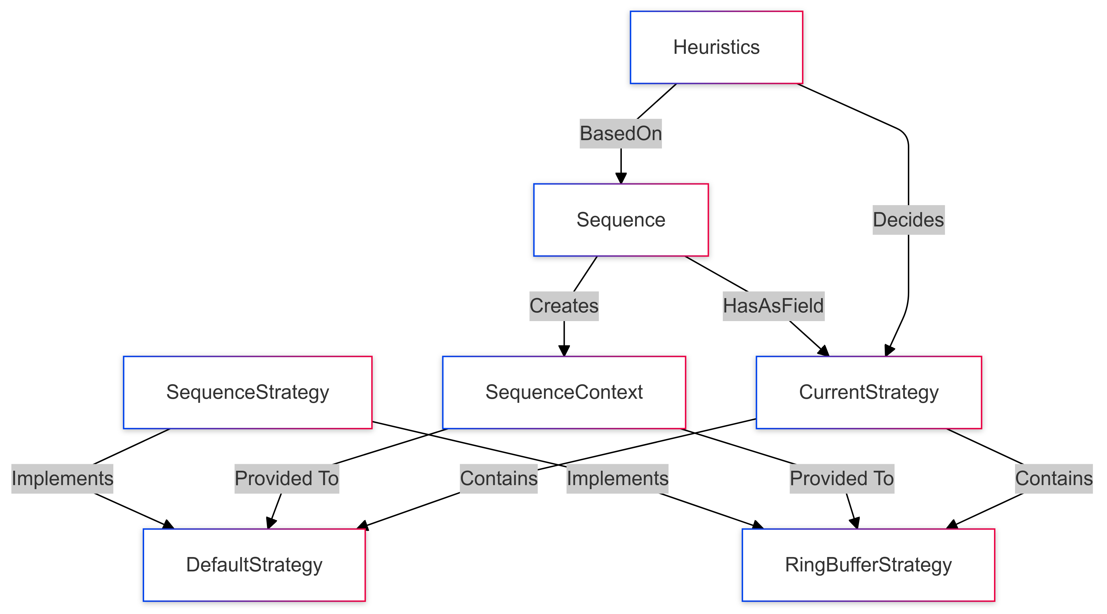
Diagram
Here is a rough idea as to how the Sequence class decides what implementation to use. Sequence has a field called CurrentStrategy which can either be DefaultStrategy or RingBufferStrategy. These in turn implement SequenceStrategy an interface that defines what at minimum should be included in the Sequence. Sequence Context is a data type which contains important information about the arrays. It is passed between the different strategies if we wish to swap. All strategies must implement functions for exporting and importing both the array and context.

Slide 7
About the heuristic
Switching only takes place when we are sure that the user wants the array to function in a way optimal for that strategy.
For example, we will swap to a RingBuffer if we are sure that we are functioning as a queue. It is an optimal strategy for that as well as a stack.
The default will be most common, it’s a good general-purpose implementation.
If 80% of operations that are done over a sample of 100 then we can assume that we are functioning as a queue. The 20 operations that are not queue specific could have been in order to setup the array and then the last 80 queue specific in which case we would switch.
Operations that are not specific are not counted towards the heuristic. (Anything being sorted counts towards default).

Slide 8
Sorting
This is one of the more complex features that this library allows. The sequence may be sorted based on a comparator that is specified at either instantiation or at any point in the lifecycle of the data.
Operations become faster on a sorted Sequence* methods such as contains and firstIndexOf become much faster when we have information about the array.
When sorted all insertions will be placed in the correct location. This however does not include insert itself. This is a special case which if used incorrectly means you can break the sorting of the Sequence.
*In a RingBuffer with an inversion operations become linear for sorted versions

Slide 9
How to use sorting
sort(*Comparator<E> comparator)
The argument is optional. If no comparator is set one can be placed here. It will sort the array and store the comparator in defaultComparator. It will NOT enforce sorting from this point.
If a comparator is already specified, then it will just use that.
sortOnwards(*Comparator<E> comparator)
This argument is also optional (Same as above). However, this will keep the Sequence in a sorted state from this point. All modifications to the array will happen in a sorted manner.
stopSorting()
The inverse of the above. Will stop the array sorting but will NOT revert to a pre-sorted version.
setComparator(Comparator<E> comparator)
Sets the defautComparator for the class
sortCopy(Comparator<E> comparator)
Returns a copy of the array sorted by the given comparator.

Slide 10
Philosophy of Sequence
The sequences performance is comparable to that of an ArrayList. Only slightly slower. But with many more features.
The structure is as flexible as you want it to be. Everything is customisable. If you’re aware of a max size of your array. Great put it in the constructor. You want a different minimum growth for a small array, put it in the constructor.
The more you know about the sequence the faster it can become.
But beyond performance the sequence is versatile. Coming with builtin methods that other collections do not. Sorting can be done automatically.
The sequence is convenient above all. It can quickly change between functioning as a queue and a stack to a sorted array in just 3 lines of code.
The sequence gives you full control or no control over the internal implementation. The more experienced you are the more you can control.

